Slide 1
Classification
Dr. Saravanan R
Professor/IT

Slide 2
Classification
Popular Classification algorithms are:
Logistic Regression
Naive Bayes
K-Nearest Neighbours
Decision Trees
Random Forest
Support Vector Machine

Slide 3
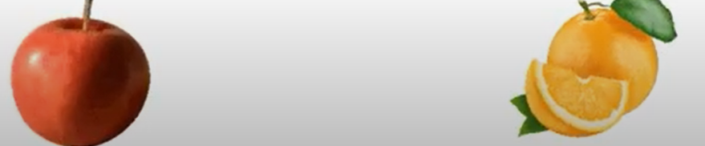
Support Vector Machine (SVM)
Apple
Orange
Classify based on its features like color, shape,

Slide 4
Support Vector Machine (SVM)
SVM – used to classify things to different groups
Algorithm used for
classification and
regression problems.
Extremely popular because of their ability to handle multiple continuous and categorical variables
Supervised Learning

Slide 5
Support Vector Machine (SVM)
SVM – used to classify things to different groups
Two Types
Linear
Non - Linear

Slide 8
Line
Straight Line
Classifies the blue color and orange color
Called Hyperplane

Slide 9
HyperPlane
Straight Line
Classifies the blue color and orange color
Called Hyperplane

Slide 10
HyperPlane
Hyperplane

Slide 11
HyperPlane
Hyperplane

Slide 12
HyperPlane
Hyperplane

Slide 13
HyperPlane
Hyperplane

Slide 14
HyperPlane
Hyperplane
Support Vector

Slide 15
HyperPlane
Hyperplane
Support Vector
Support Vector

Slide 16
HyperPlane
Hyperplane
Support Vector
Support Vector

Slide 17
HyperPlane
Hyperplane
Margin
Support Vector
Support Vector

Slide 18
HyperPlane
Hyperplane
Margin
Support Vector
Support Vector

Slide 19
HyperPlane
Hyperplane
Margin
Support Vector
Margin
Support Vector

Slide 20
HyperPlane
Hyperplane
Margin
Support Vector
Margin
Support Vector

Slide 21
HyperPlane
Maximized
Margin
Hyperplane
Margin
Support Vector
Margin
Support Vector

Slide 22
HyperPlane
Maximized
Margin
Hyperplane
Margin
Support Vector
Maximized Margin
Support Vector

Slide 23
HyperPlane
Maximized
Margin
Hyperplane
Margin
Support Vector
Margin
Support Vector

Slide 24
Optimal
HyperPlane
Maximized
Margin
Hyperplane
Margin
Support Vector
Margin
Support Vector

Slide 25
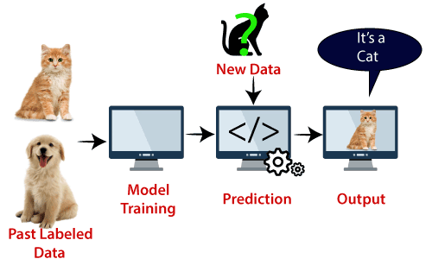

Slide 28
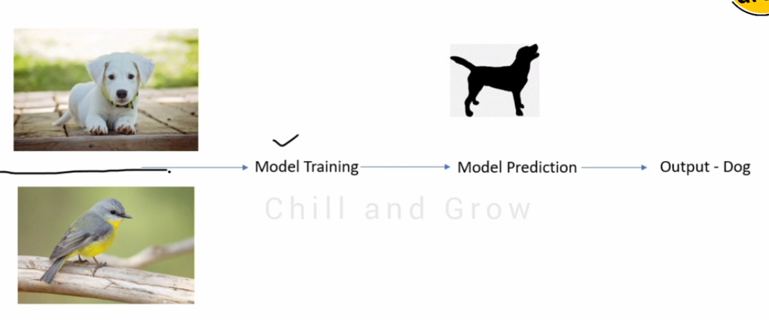

Slide 29
Linear SVM

Slide 30
Support Vector Machine (SVM)
Hyperplane: A hyperplane aka decision boundary/surface is an n-dimensional Euclidean space that distinctly separates the data points. The data points on either side of the hyperplane belong to different classes. If we have a p-dimensional feature set, the dimension of the hyperplane will be p-1.
Support Vectors: The individual data points that are close to the hyperplane are called the support vectors.
Margin: The width that the boundary could be increased before hitting a data point. In simple terms, the distance between the hyperplane and the support vectors is referred to as the Margin.

Slide 31
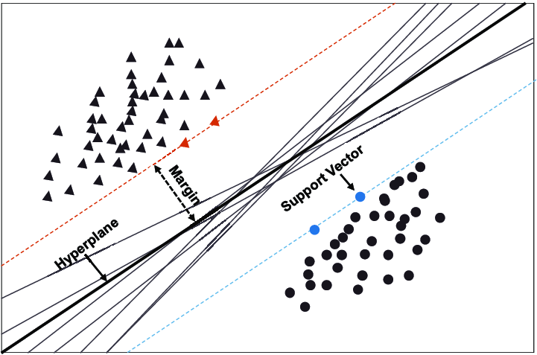

Slide 32

SVM chooses the extreme points/vectors that help in creating the hyperplane.
These extreme cases are called as support vectors, and hence algorithm is termed as Support Vector Machine.
Two different categories that are classified using a decision boundary or hyperplane

Slide 33
SVM algorithm can be used for Face detection, image classification, text categorization

Slide 34
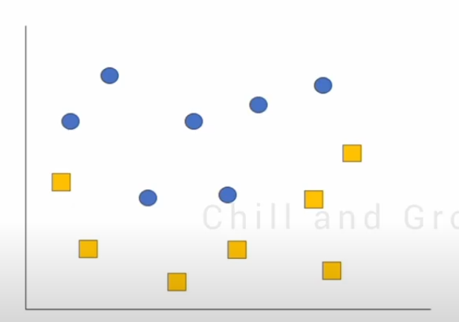
Non-Linear

Slide 35
Non-Linear

Slide 36
Non-Linear

Slide 37
Non-Linear

Slide 38
Non-Linear
Not a Straight Line
Converting from 2D dataset to 3D Dataset

Slide 39
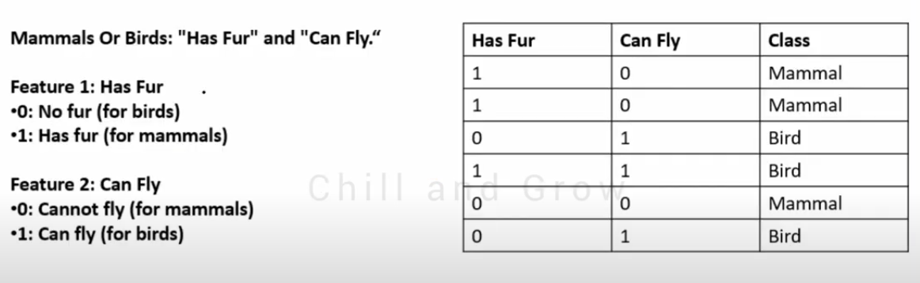

Slide 40
Class – 2( Mammal or Bird)

Slide 41
Class – 2( Mammal or Bird)

Slide 42
Class – 2( Mammal or Bird)
Feature – 2 (Has Fur and Can Fly)

Slide 43
Class – 2( Mammal or Bird)
Feature – 2 (Has Fur and Can Fly)

Slide 44
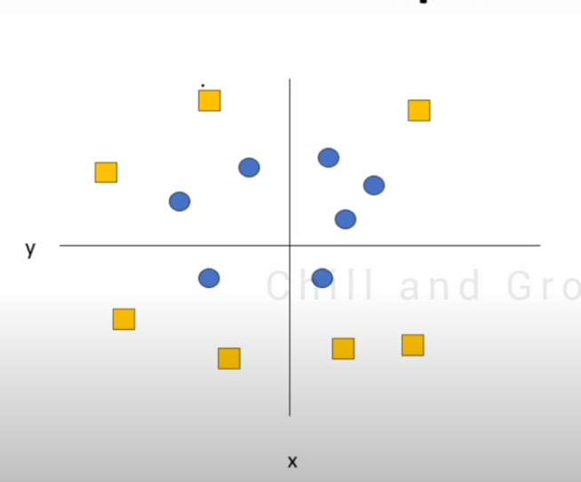

Slide 46
Hyperplane

Slide 47
Convert 2D – 3D

Slide 48
3D space with Kernel

Slide 49
3D space with Kernel

Slide 50
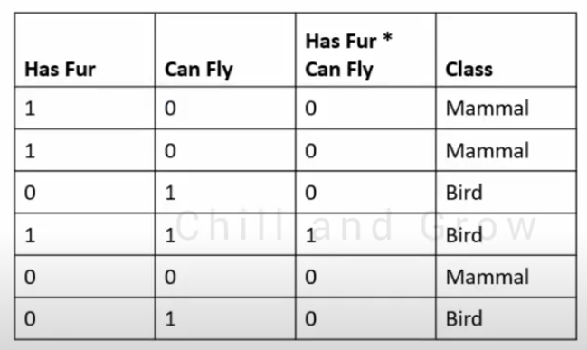
3D space with Kernel

Slide 51
3D space with Kernel

Slide 52
3D space with Kernel

Slide 53
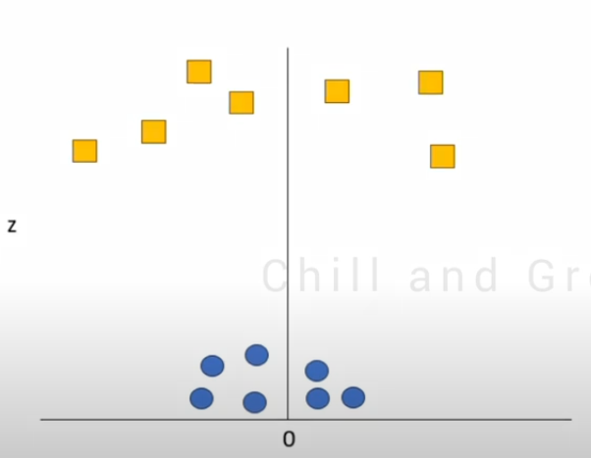
Hyperplane

Slide 54
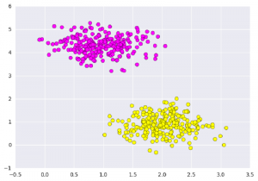
# importing scikit learn with make_blobs
from sklearn.datasets import make_blobs
# creating datasets X containing n_samples
# Y containing two classes
X, Y = make_blobs(n_samples=500, centers=2,
random_state=0, cluster_std=0.40)
import matplotlib.pyplot as plt
# plotting scatters
plt.scatter(X[:, 0], X[:, 1], c=Y, s=50, cmap='spring');
plt.show()

Slide 55
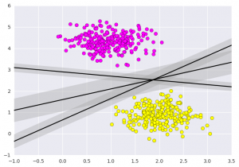
# creating linspace between -1 to 3.5
xfit = np.linspace(-1, 3.5)
# plotting scatter
plt.scatter(X[:, 0], X[:, 1], c=Y, s=50, cmap='spring')
# plot a line between the different sets of data
for m, b, d in [(1, 0.65, 0.33), (0.5, 1.6, 0.55), (-0.2, 2.9, 0.2)]:
yfit = m * xfit + b
plt.plot(xfit, yfit, '-k')
plt.fill_between(xfit, yfit - d, yfit + d, edgecolor='none',
color='#AAAAAA', alpha=0.4)
plt.xlim(-1, 3.5);
plt.show()

